Slide 1


Meesho Marketplace Analytics And Business Intelligence Dashboard
BUSINESS INTELLIGENCE PROJECT
Sales · Returns · Refunds · Delivery · Risk Analysis
Presented By
Dharshini Priya L
AF05252039
B.Tech Artificial Intelligence And Data Science
ANP-D3676 Data And Business Analyst With AI

Slide 2



PROJECT OVERVIEW
A Unified View of Marketplace Performance
The project is a Business Intelligence solution built to analyse marketplace data and translate it into meaningful insight across sales, orders, returns, refunds, delivery, seller performance and customer risk.
THREE DASHBOARD PAGES
01
Executive Dashboard
Overall marketplace performance
MySQL for structured storage of customers, orders, products, returns, sellers and delivery data
Power BI for data modelling, relationships, DAX calculations and visualization
02
Return Intelligence
Returns, refunds & customer risk
Three interactive dashboard pages built on a single connected data model
DASHBOARD SNAPSHOT
03
Performance & Risk Score
4K
₹6.91M
13.99%
82.58
Seller performance & delivery risk
Orders
Sales
Return Rate
Avg Seller Score
MEESHO MARKETPLACE ANALYTICS DASHBOARD
02

Slide 3





INDUSTRY CONTEXT
Why a Marketplace Needs Analytics
E-commerce marketplaces generate large volumes of data through orders, payments, deliveries, returns, refunds and seller activity — but that data is spread across many disconnected tables, making it hard to see the full performance picture.
Difficulty monitoring overall order & sales performance
No clear view of monthly sales and return trends
Return reasons and high-return products go unidentified
Financial impact of refunds is hard to quantify
Delivery delays are not tracked systematically
No easy way to flag high-risk sellers or customers
MEESHO MARKETPLACE ANALYTICS DASHBOARD
03

Slide 4





TOOLS & TECHNOLOGIES
The Analytics Stack
CSV Dataset
MySQL
Power BI
Power Query
DAX
Original synthetic marketplace dataset generated using python and stored as csv files.
Structured relational storage across 6 linked tables
Modelling, DAX calculations, KPIs & interactive visuals
Data preparation and transformation layer
Calculated measures & columns behind every KPI
MEESHO MARKETPLACE ANALYTICS DASHBOARD
04

Slide 5

DATASET
Dataset Introduction & Source
The dataset was not taken from an external source. I generated a synthetic Meesho marketplace dataset using Python to simulate realistic e-commerce data. The generated data was stored as CSV files, imported into MySQL as six related tables, and then connected to Power BI for analysis and dashboard development.
SIX CONNECTED TABLES
meesho_project_customers
meesho_project_orders
CSV → MySQL Import → Power BI Connection
meesho_project_products
meesho_project_returns
meesho_project_sellers
meesho_project_delivery
MEESHO MARKETPLACE ANALYTICS DASHBOARD
05

Slide 6
DATABASE DESIGN
MySQL — Database & Table Structure
Customers
Orders
Products
customer_id, name, age, gender, city, state, segment, signup_date
order_id, customer_id, product_id, seller_id, dates, payment, amount
product_id, category & product-level return performance
Returns
Sellers
Delivery
return_id, order_id, reason, category, status, refund_amount
seller_id, seller_name, city, state, rating, seller_since
status, delivery days, delay days, region, warehouse info
MEESHO MARKETPLACE ANALYTICS DASHBOARD
06

Slide 7



INTEGRATION
Connecting MySQL with Power BI
01
02
03
04
Get Data → MySQL Database
→
Select the Six Tables
→
Build Relationships
→
Validate the Model
Power BI connects directly to the MySQL server using the MySQL connector
Customers, Orders, Products, Returns, Sellers and Delivery are loaded
Tables linked via Customer ID, Order ID, Product ID and Seller ID
Relationships checked so cross-filtering works correctly across visuals
MEESHO MARKETPLACE ANALYTICS DASHBOARD
07

Slide 8


DATA PREPARATION
Loading Data (ETL) & Cleaning
Power Query served as the ETL layer between MySQL and the Power BI model — loading, checking and preparing the six tables before any DAX was written.
FIELDS CHECKED DURING CLEANING
Data Types
Date Fields (order, delivery, return)
Load
Tables imported from MySQL into the Power BI / Power Query editor
Numerical Fields (amounts, quantities)
Clean
Categorical Fields (status, reason, method)
Data types, date fields, numeric & categorical fields verified and corrected
Relationship Keys Between Tables
Shape
Fields prepared to support relationship keys across all six tables
MEESHO MARKETPLACE ANALYTICS DASHBOARD
08

Slide 9
CALCULATIONS
Basic DAX Measures
Total Orders
Total Returns
Total Refund
Count of related customer orders
Unique return records per customer
Refund amount on returned orders
Return Rate
Average Refund
Average Order Value
Total Returns ÷ Total Orders × 100 · Live: 13.99%
Average refund per returned order
Average revenue generated per order
Delay Rate
Seller Performance Score
Customer Risk Score
Proportion of delayed orders · Live: 48.75%
Composite seller scoring measure · Live avg: 82.58
Rule-based return/refund risk indicator
MEESHO MARKETPLACE ANALYTICS DASHBOARD
09

Slide 10



DASHBOARD DESIGN
Three Pages, One Connected Model
01
02
03
Executive Dashboard
Return Intelligence
Performance & Risk Score
4K orders · ₹6.91M in sales · 13.99% return rate · 48.75% delay rate
558 returns · ₹880.69K refunded · Top reason: Not as Expected
82.58 avg seller score · 21.7% seller risk rate · 65 high-risk sellers
MEESHO MARKETPLACE ANALYTICS DASHBOARD
10

Slide 11
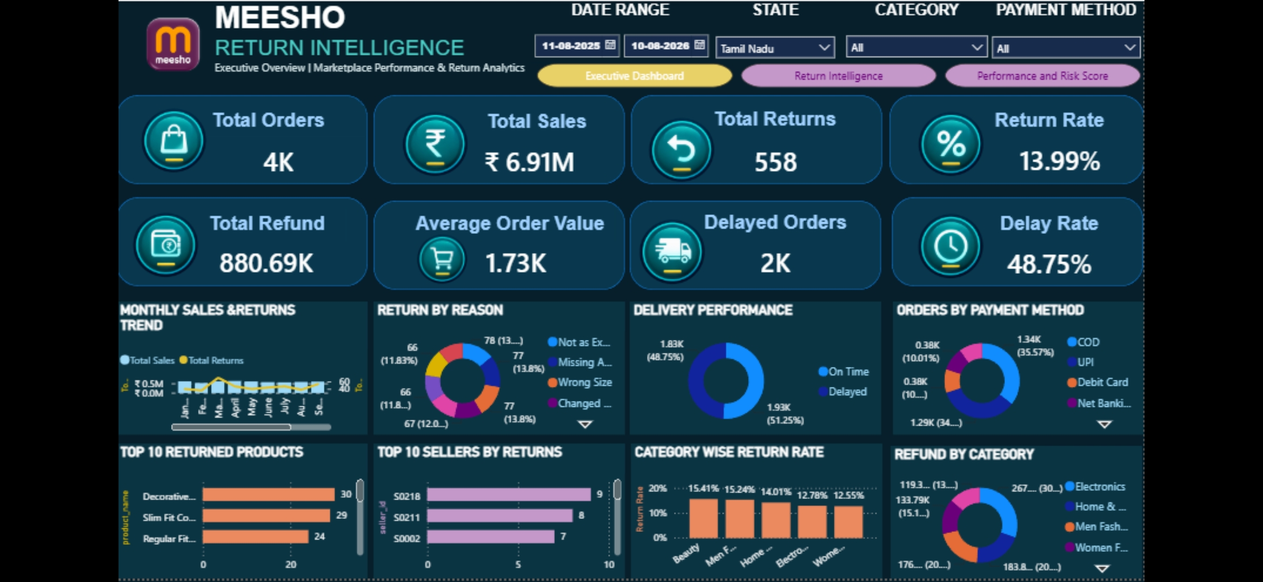
EXECUTIVE DASHBOARD
Executive Dashboard — View
4K orders · ₹6.91M sales · 558 returns (13.99%) · ₹880.69K refunded · 48.75% delayed
MEESHO MARKETPLACE ANALYTICS DASHBOARD
11

Slide 12
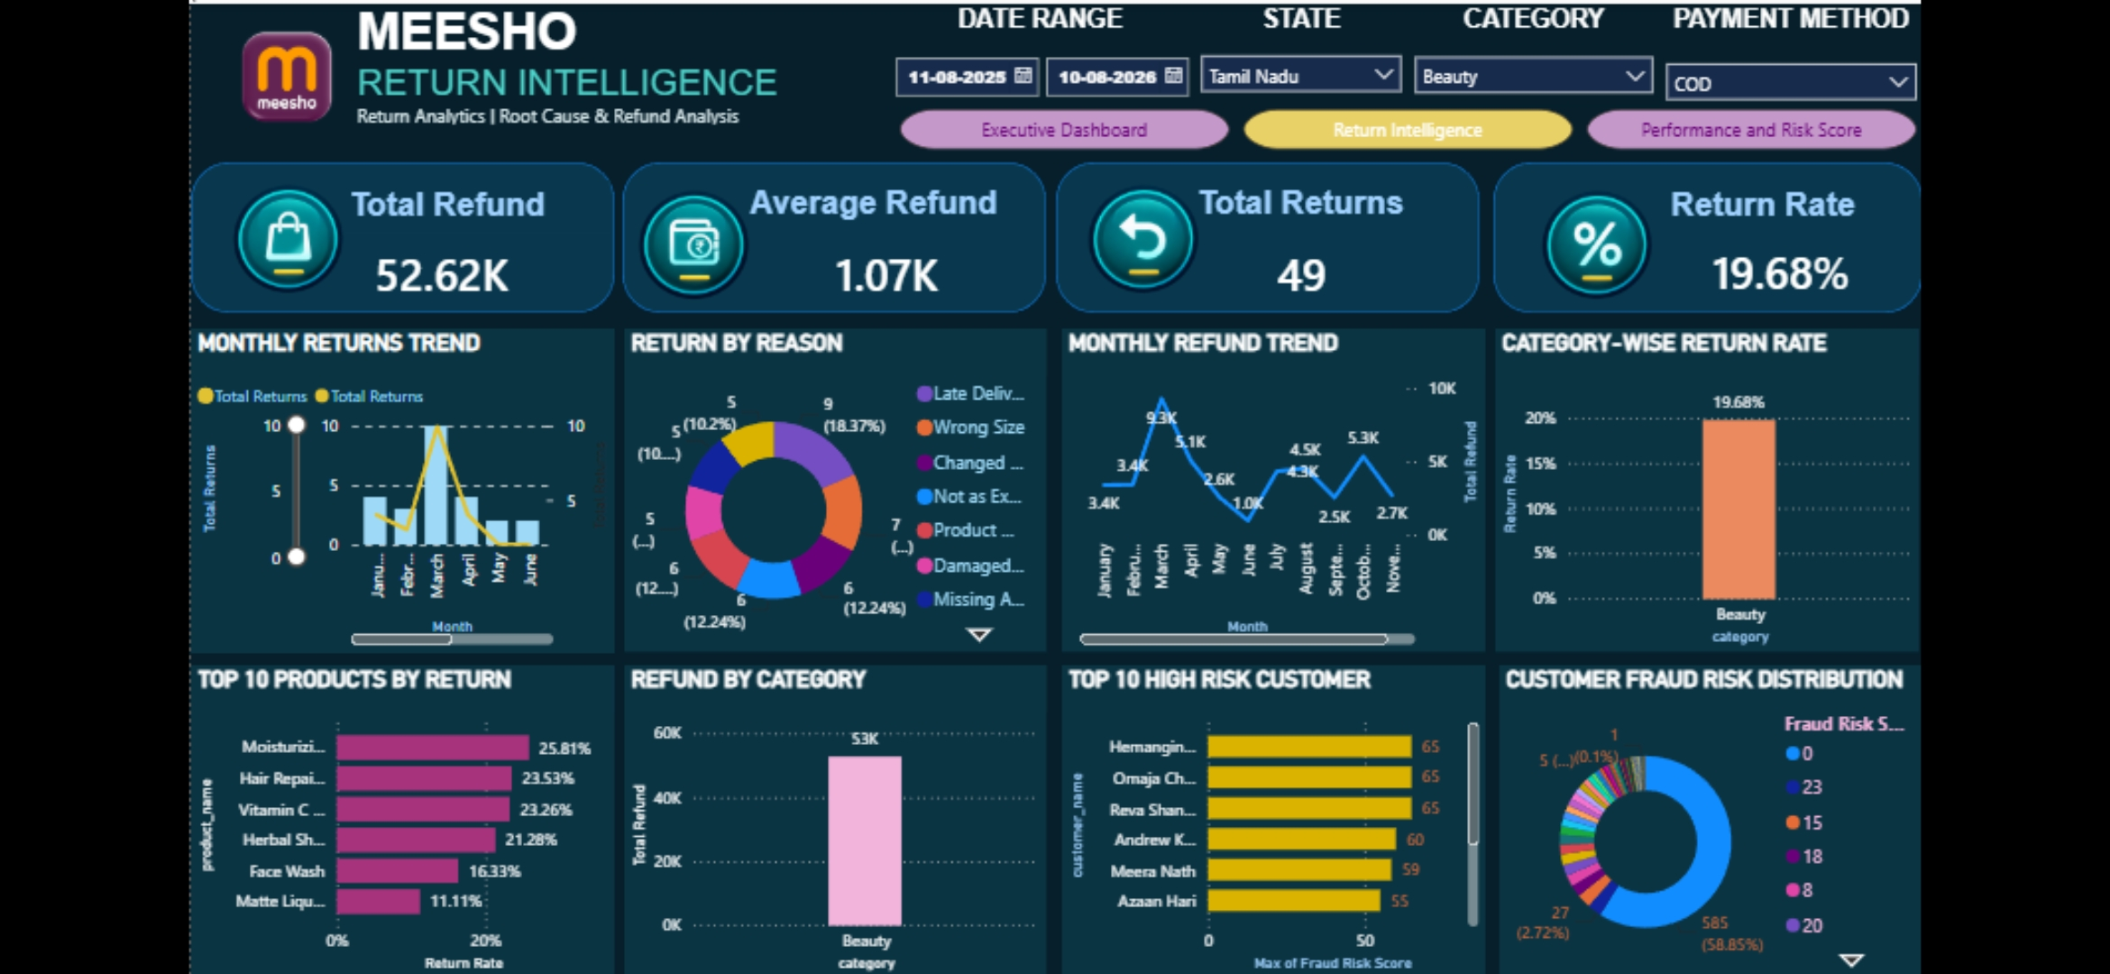
RETURN INTELLIGENCE
Return Intelligence — View
Filtered: Tamil Nadu · Beauty · COD — 49 returns, 19.68% return rate, ₹52.62K refunded
MEESHO MARKETPLACE ANALYTICS DASHBOARD
12

Slide 13
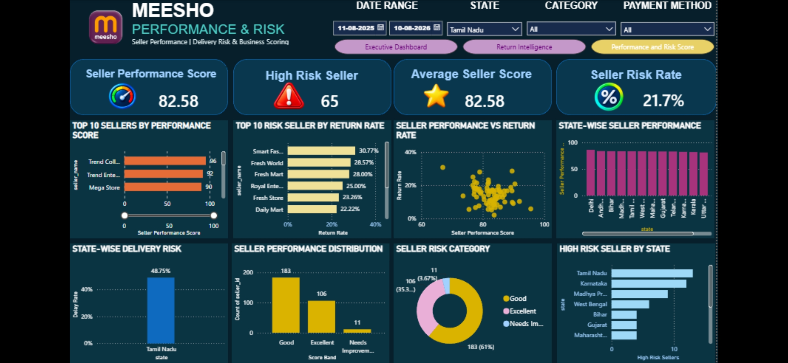
PERFORMANCE & RISK SCORE
Performance & Risk Score — View
Filtered: Tamil Nadu — 82.58 avg seller score, 21.7% seller risk rate, 61% of sellers rated Good
MEESHO MARKETPLACE ANALYTICS DASHBOARD
13

Slide 14

INTERACTIVITY
Filters & Slicers
Date Range
State
Category
Select the required reporting period
Filter the entire dashboard by state
Filter analysis by product category
Payment Method
Page Navigation
Cross Filtering
Filter orders by payment type
Buttons to move across all three pages
Selections in one visual filter related visuals
MEESHO MARKETPLACE ANALYTICS DASHBOARD
14

Slide 15


FINDINGS
Key Insights from the Dashboard
Marketplace Performance
Return Behaviour
4,000 orders generated ₹6.91M in sales at an average order value of ₹1.73K, with ₹880.69K refunded overall
13.99% return rate (558 orders); Not as Expected, Missing Accessories & Wrong Size are near-equal top reasons (~13.8% each)
Refund Impact
Delivery Performance
Electronics drives the largest refund share (~30%), followed by Home & Men's Fashion (~20% each)
48.75% of orders were delivered late — a pattern that shows up as high delay risk in states like Tamil Nadu
Seller Performance & Risk
Customer Risk
Average seller score is 82.58; 61% of sellers rate Good and just 3.67% need improvement — but 21.7% still carry return-risk flags
Top-flagged customers reach fraud-risk scores up to 65, though the large majority (585 of ~590, ~59%) score a clean 0
MEESHO MARKETPLACE ANALYTICS DASHBOARD
15

Slide 16
METHODOLOGY
Project Workflow
MySQL Import
Data Prep & Modelling
Interactive Visuals
1
3
5
7
CSV Dataset
Power BI Connection
DAX Measures & KPIs
3-Page Dashboard
2
4
6
MEESHO MARKETPLACE ANALYTICS DASHBOARD
16

Slide 17

PROJECT REPOSITORY
GitHub Repository
Add your repository link here
https://github.com/jonathpriya/meesho-marketplace-analytics.git
REPOSITORY CONTENTS
MySQL table creation & import scripts
Power BI (.pbix) dashboard file
Dataset
Dashboard screenshots
Full project report
MEESHO MARKETPLACE ANALYTICS DASHBOARD
17

Slide 18
THANK YOU!!!
MEESHO MARKETPLACE ANALYTICS DASHBOARD
17

